Slide 1
Predicting Patient Survival: A Data-driven Analysis
- Based on European Cancer data Survival Dataset

Slide 2
This name encapsulates the objective of predicting patient survival rates based on diagnosis and treatment outcomes in the EU region, which Is shown in focus in visual presentation and the analysis of data.

Slide 3
Sequence of analysis carried out on the provided dataset
Data Cleaning:
Describe the steps taken to clean the dataset (handling missing values, etc.).
Mention any transformations or encoding performed.
Exploratory Data Analysis (EDA):
Showcase visualizations of key features (age distribution, survival rate by gender, etc.).
Interpret insights gained from the visualizations.
Model Building:
Approach to model building (e.g., selecting algorithms, splitting data).
Present the chosen ML algorithm and evaluation metrics.
Results and Interpretation:
Discuss the performance of the ML model in predicting survival rates.

Slide 4
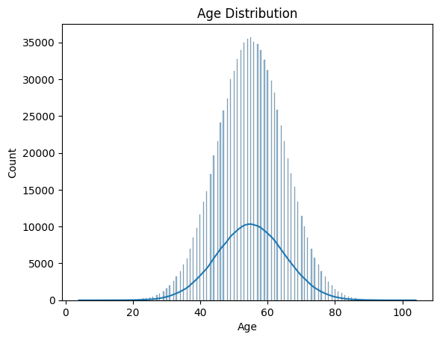
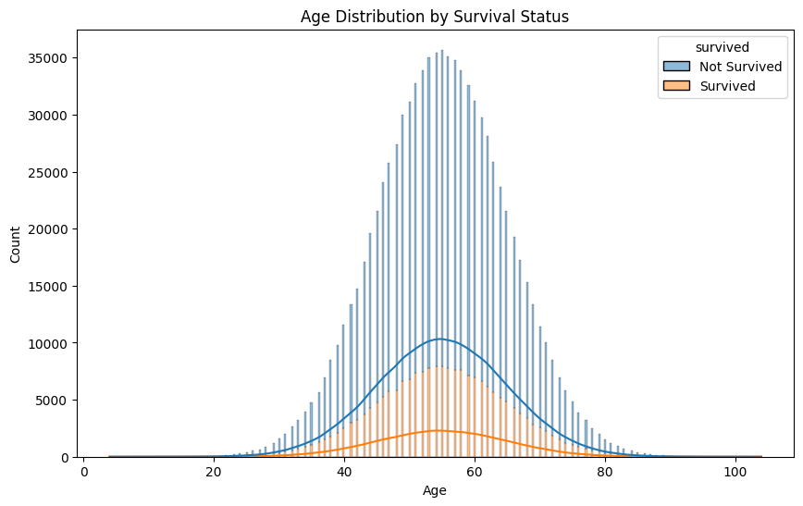
Insights found out during EDA Analysis:
The Highest range of Age group of People present in the data is between 45-70 age group and considering the survival rate is quite low for the same.

Slide 5
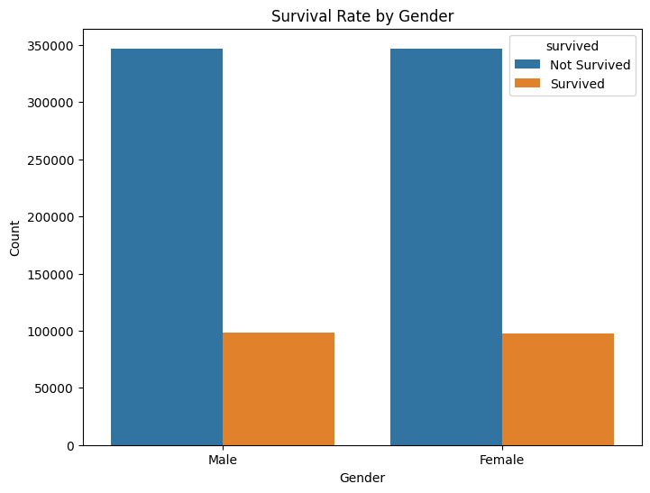
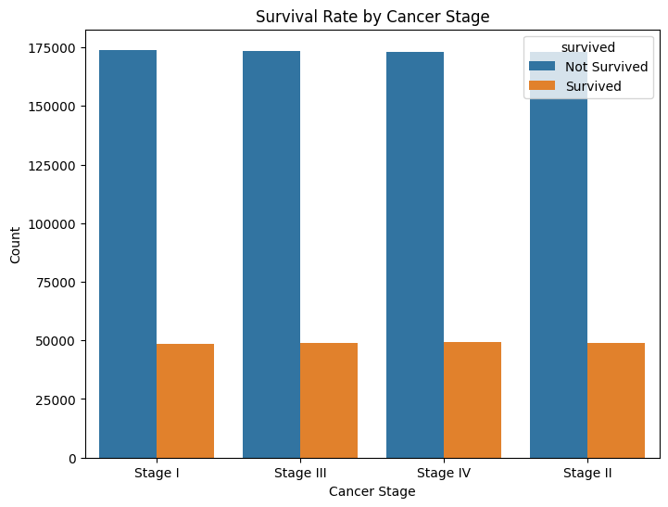
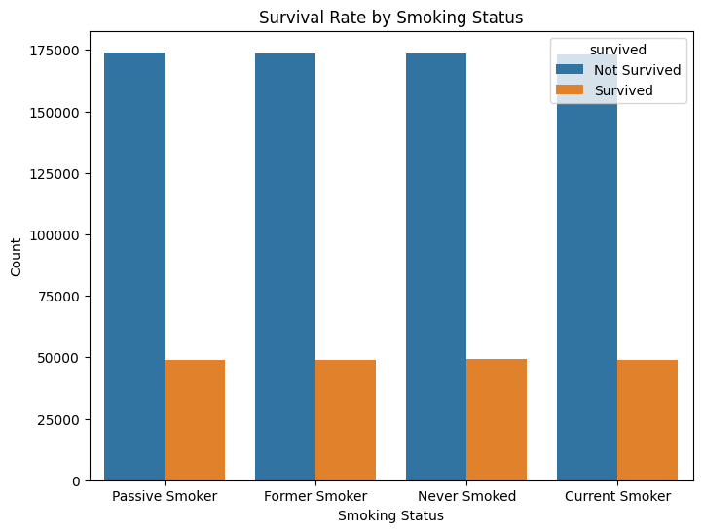
Insights found out during EDA Analysis:
While plotting the Survival Status against factors (Features in a dataset) like Gender, Cancer Stage, Smoking Status, Treatment type, Country and Family History we see a similar trend which showcases that the survival rate is quite less.
GENDER
CANCER STAGE
SMOKING STATUS

Slide 6
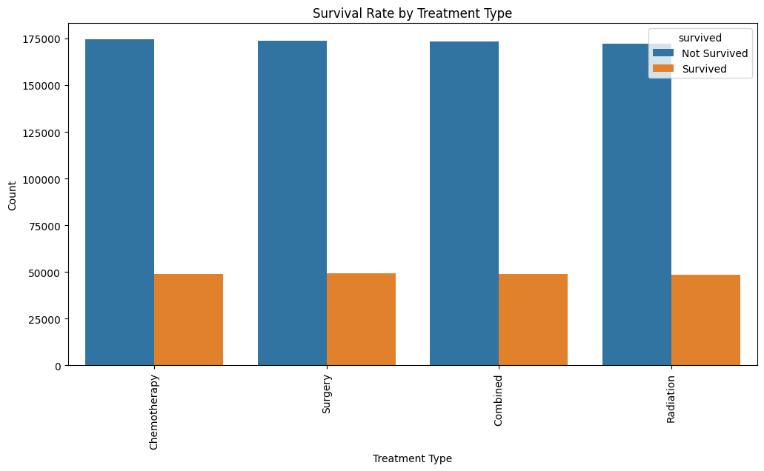
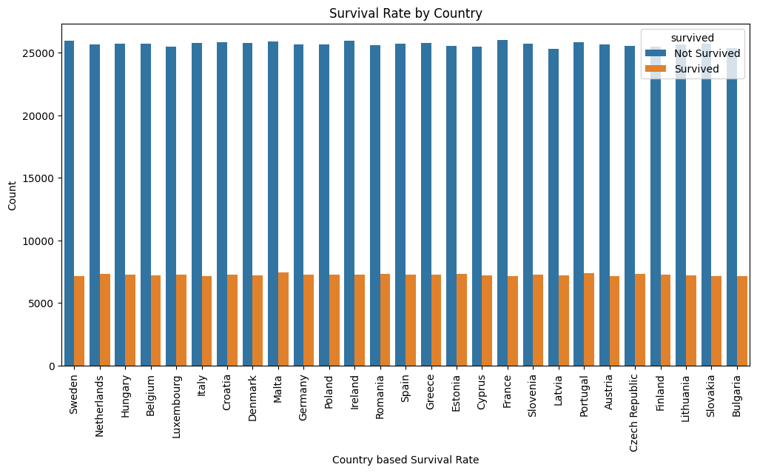

Insights found out during EDA Analysis:
TREATMENT TYPE
COUNTRY BASED
FAMILY HISTORY

Slide 7
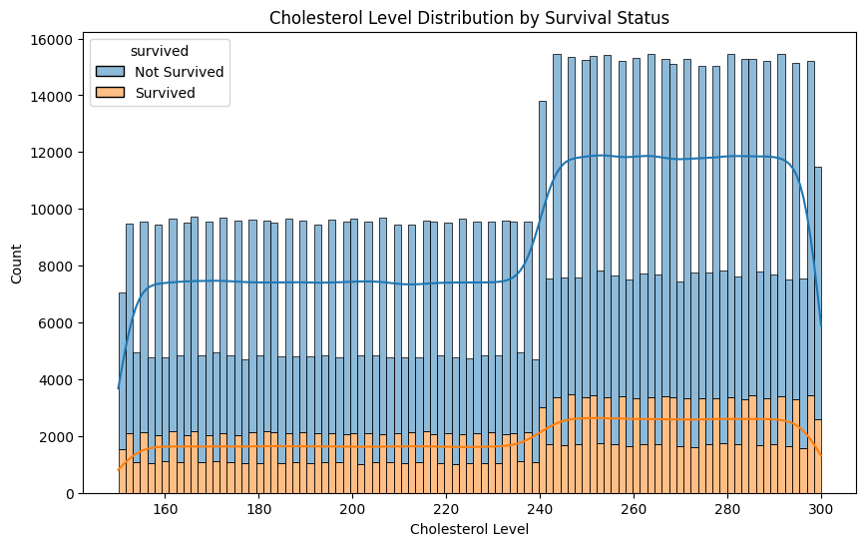
Insights found out during EDA Analysis:
While plotting the Survival Status against factors (Features in a dataset) like Cholesterol level we see the rate of Not Surviving is higher as the Cholesterol level is higher.

Slide 8
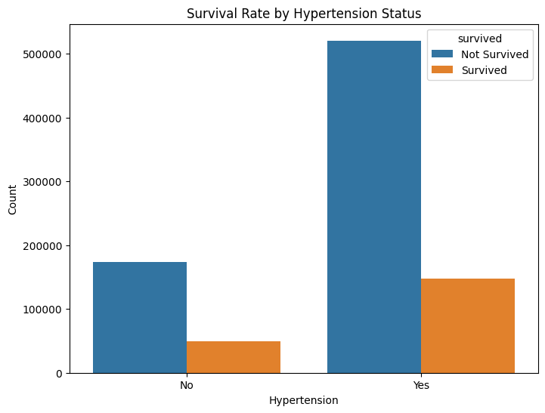
Insights found out during EDA Analysis:
While plotting the Survival Status against factors (Features in a dataset) like Hypertension Status we see the rate of Not Survived/Survived is higher which people having Hypertension.

Slide 9
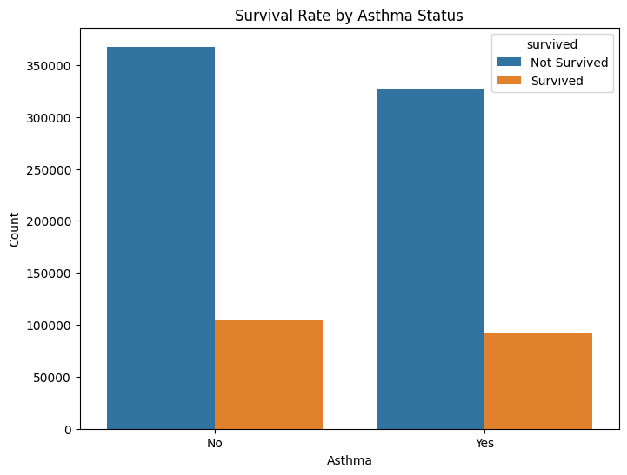
Insights found out during EDA Analysis:
While plotting the Survival Status against factors (Features in a dataset) like Asthma we see the rate of Not Survived/Survived is sightly higher with people not having Asthma the those having Asthma.

Slide 10
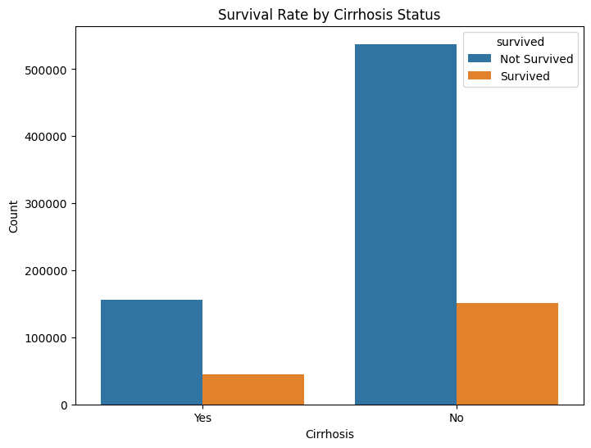
Insights found out during EDA Analysis:
While plotting the Survival Status against factors (Features in a dataset) like Asthma we see the rate of Not Survived/Survived is higher with people not having Cirhossis the those having Cirhossis.

Slide 11
Insights found out during EDA Analysis:
While plotting the Survival Status against factors (Features in a dataset) like Cirhossis we see the rate of Not Survived/Survived is higher with people not having Cirhossis the those having Cirhossis.

Slide 12
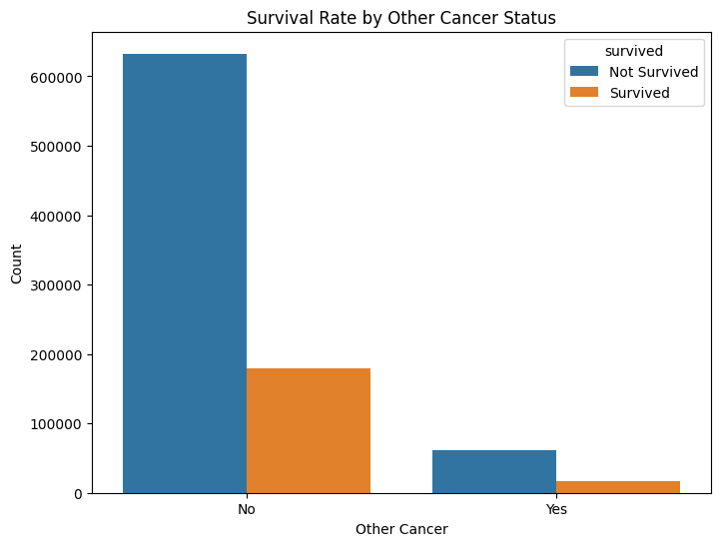
Insights found out during EDA Analysis:
While plotting the Survival Status against factors (Features in a dataset) like Other Cancer we see the rate of Not Survived/Survived is higher with people not having Other Cancer Status the those having Other Cancer Status .

Slide 13
ML Model building
Considering the given features present in the dataset we can develop a ML model.
The ML model can provide insights how well we can predict survival rates using available Patient info.
The model developed provides an Accuracy of 78% to predict the survival rate.

Slide 14
Thank You

